Slide 1
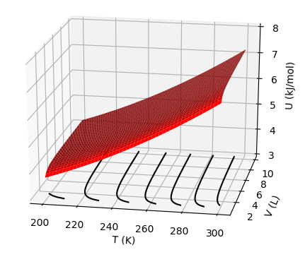



The differential equation of state – U(T,V)
$${\left(\frac{∂U}{∂T}\right)}_{V}$$
$${\left(\frac{∂U}{∂V}\right)}_{T}$$
$$dU={{\left(\frac{∂U}{∂T}\right)}_{V}dT+ \left(\frac{∂U}{∂V}\right)}_{T}dV=C_{V}dT+π_{T}dV$$

Slide 2
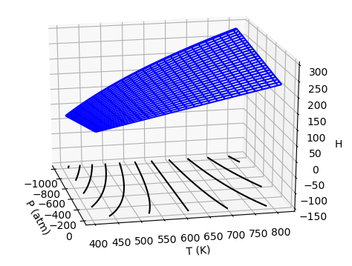



The differential equation of state – H(T,P)
$${\left(\frac{∂H}{∂T}\right)}_{P}$$
$${\left(\frac{∂H}{∂P}\right)}_{T}$$
$$dH={{\left(\frac{∂H}{∂T}\right)}_{P}dT+ \left(\frac{∂H}{∂P}\right)}_{T}dP=C_{P}dT+μ_{T}dP$$

Slide 3
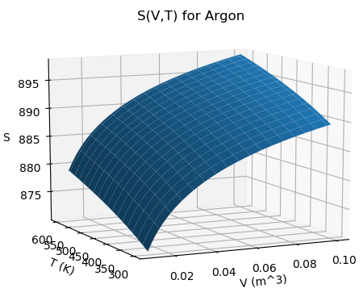
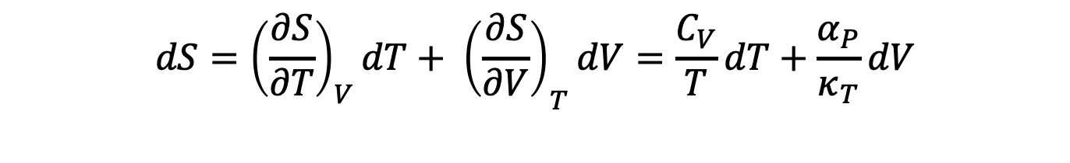


The differential equation of state – S(T,V)
$${\left(\frac{∂S}{∂T}\right)}_{V}$$
$${\left(\frac{∂S}{∂V}\right)}_{T}$$
$$dS={{\left(\frac{∂S}{∂T}\right)}_{V}dT+ \left(\frac{∂S}{∂V}\right)}_{T}dV=\frac{C_{V}}{T}dT+\frac{α_{P}}{κ_{T}}dV$$

Slide 4
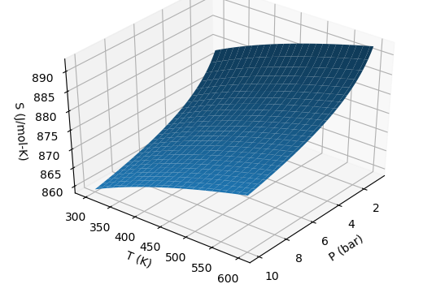
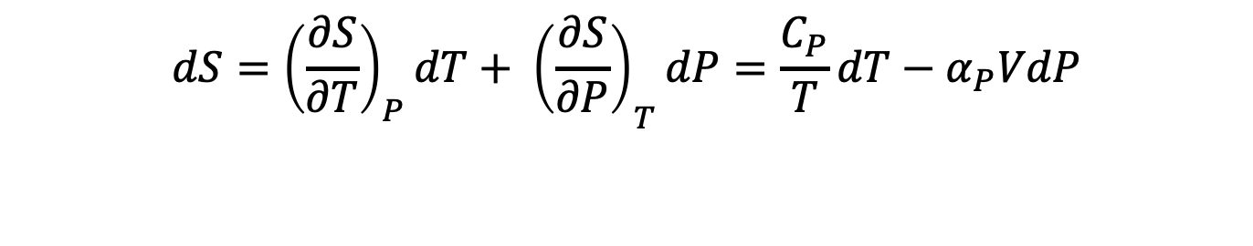


The differential equation of state – S(T,P)
$${\left(\frac{∂S}{∂P}\right)}_{T}$$
$${\left(\frac{∂S}{∂T}\right)}_{P}$$
$$dS={{\left(\frac{∂S}{∂T}\right)}_{P}dT+ \left(\frac{∂S}{∂P}\right)}_{T}dP=\frac{C_{P}}{T}dT−α_{P}VdP$$

Slide 5
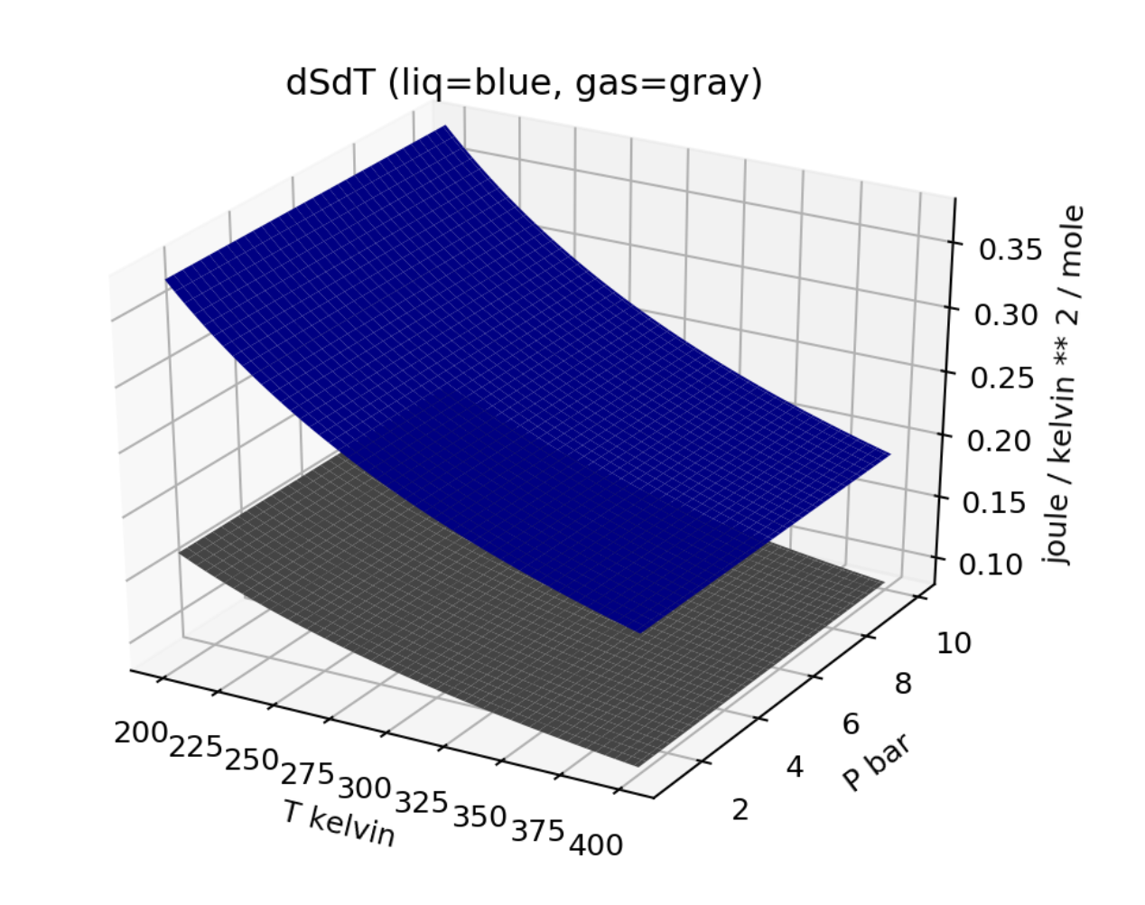
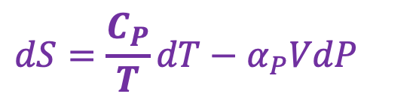
Let’s have a look at those slopes
$$dS=\frac{C_{P}}{T}dT−α_{P}VdP$$

Slide 6
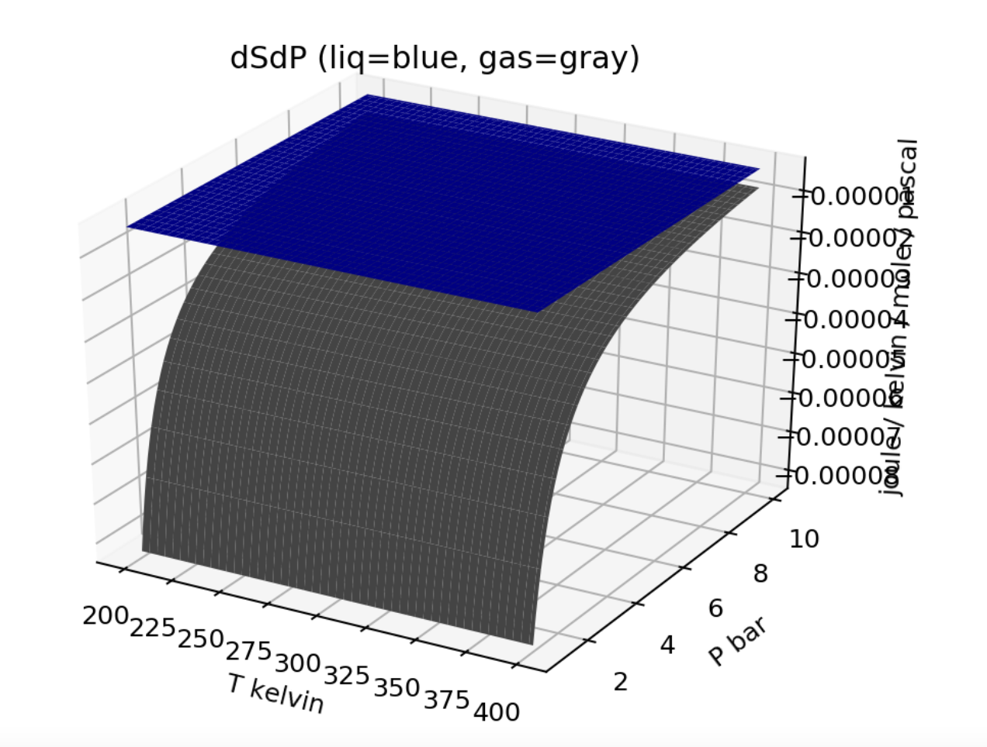
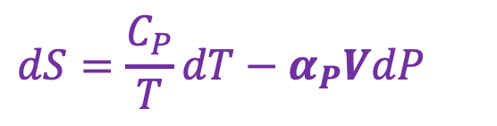
Let’s have a look at those slopes
$$dS=\frac{C_{P}}{T}dT−α_{P}VdP$$

Slide 7
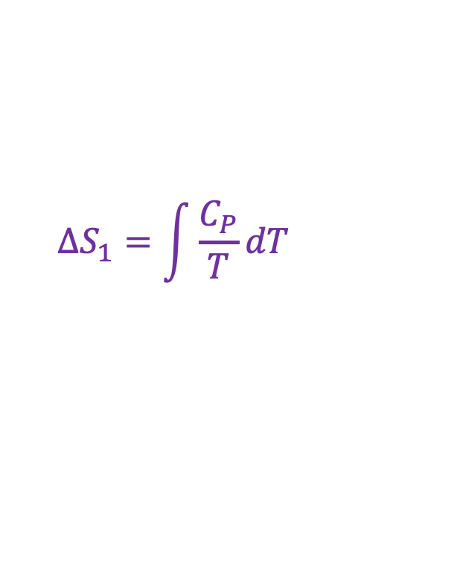

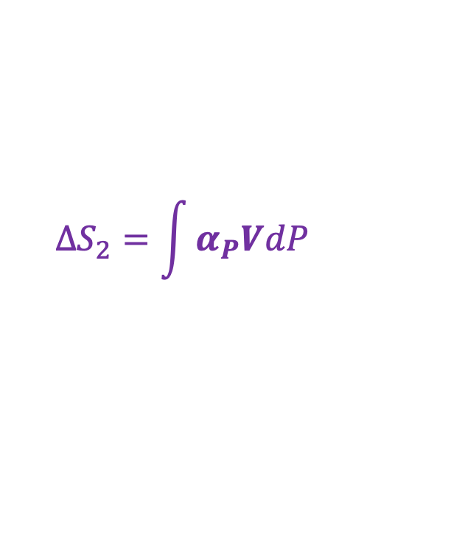
The question of path independence
$$∆S_{1}=\int{\frac{C_{P}}{T}dT}$$
$$∆S_{2}=\int{α_{P}VdP}$$
$$∆S=∆S_{1}+∆S_{2}$$

Slide 8


The question of path independence
$$∆S_{1}=\int{α_{P}VdP}$$
$$∆S_{2}=\int{\frac{C_{P}}{T}dT}$$
$$∆S=∆S_{1}+∆S_{2}$$

Slide 9
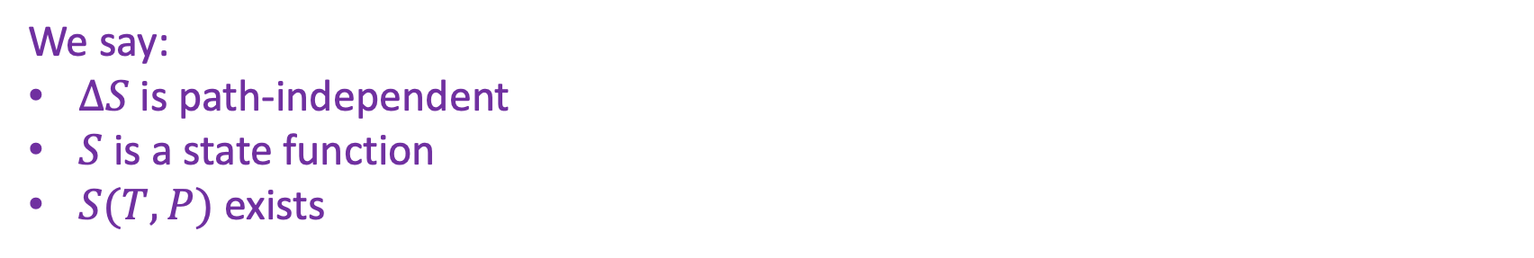
The question of path independence
We say:
$∆S$ is path-independent
$S$ is a state function
$S(T,P)$ exists

Slide 10
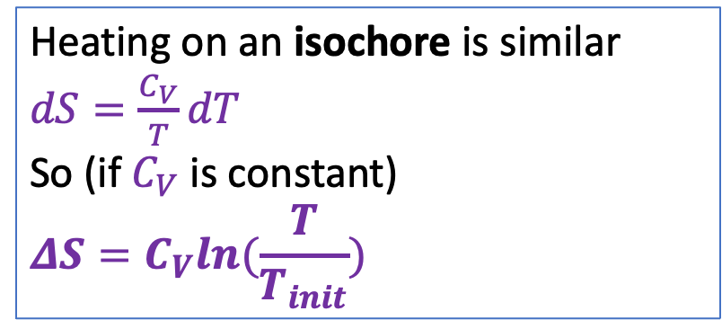
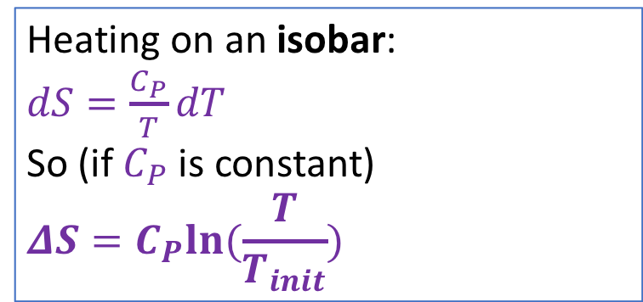
As long as the heat capacity is constant, entropy is a logarithmic function of temperature
Heating on an isobar:
$dS=\frac{C_{P}}{T}dT$
So (if $C_{P}$ is constant)
$$ΔS=C_{P}ln⁡(\frac{T}{T_{init}})$$
Heating on an isochore is similar
$dS=\frac{C_{V}}{T}dT$
So (if $C_{V}$ is constant)
$$ΔS=C_{V}ln⁡(\frac{T}{T_{init}})$$
S
T

Slide 11
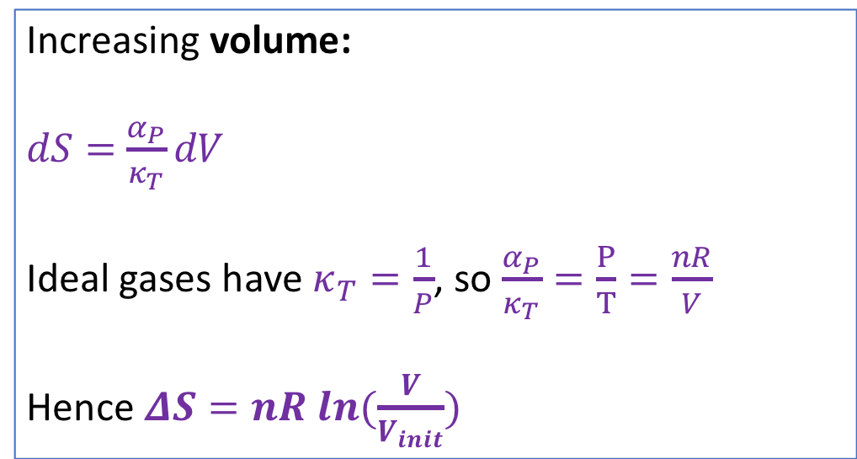
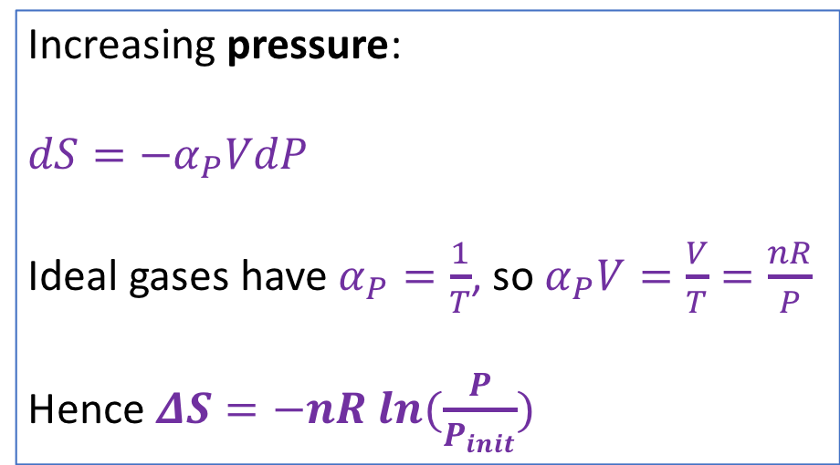
For gases, isotherms are also logarithmic!
Increasing pressure:
$dS=−α_{P}VdP$
Ideal gases have $α_{P}=\frac{1}{T}$, so $α_{P}V=\frac{V}{T}=\frac{nR}{P}$
Hence $ΔS=−nR ln⁡(\frac{P}{P_{init}})$
Increasing volume:
$dS=$ $\frac{α_{P}}{κ_{T}}dV$
Ideal gases have $κ_{T}=\frac{1}{P}$, so $\frac{α_{P}}{κ_{T}}=\frac{P}{T}=\frac{nR}{V}$
Hence $ΔS=nR ln⁡(\frac{V}{V_{init}})$
S
S
P
V

Slide 12
Leading to these results

Slide 13
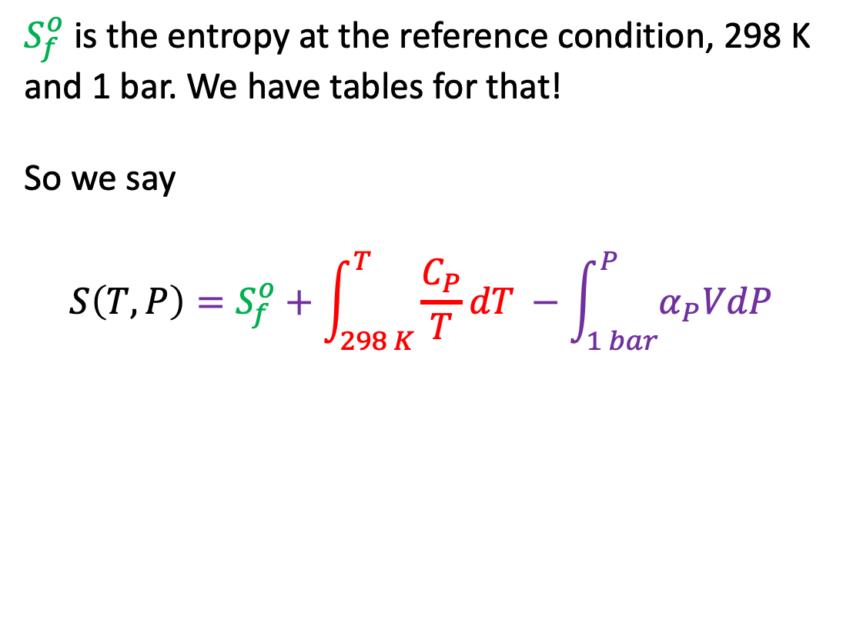
To get the actual entropy, need a starting point ($S_{f}^{o}$)
$S_{f}^{o}$ is the entropy at the reference condition, 298 K and 1 bar. We have tables for that!
So we say
$$S\left(T,P\right)=S_{f}^{o}+\int_{298 K}^{T}{\frac{C_{P}}{T}dT} −\int_{1 bar}^{P}{α_{P}VdP}$$
Notes:
$S\left(350 K\right)=S_{f}^{o}+C_{P}ln\left(\frac{T}{298}\right)=70+75 ln\left(\frac{350}{298}\right)=82\frac{J}{K}$ (see HW)

Slide 14
Entropy is a measure of choice
More choice about where to be

Slide 15
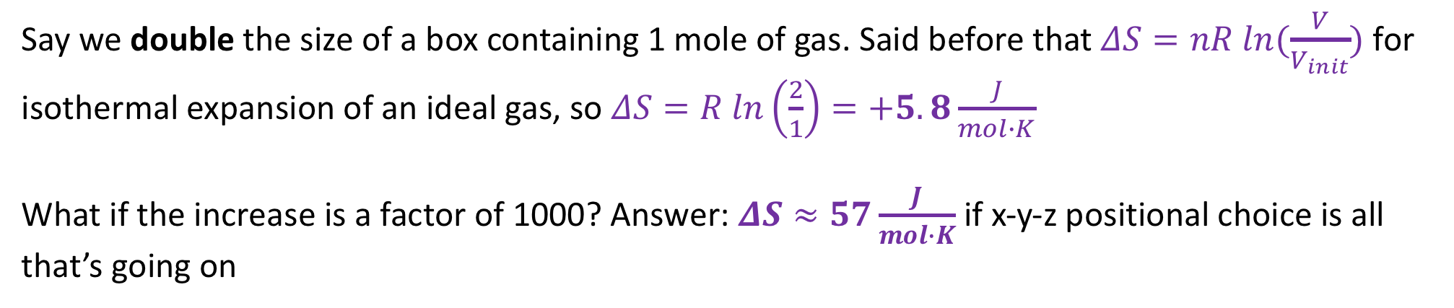
How much more choice?
More choice about where to be
Say we double the size of a box containing 1 mole of gas. Said before that $ΔS=nR ln⁡(\frac{V}{V_{init}})$ for isothermal expansion of an ideal gas, so $ΔS=R ln\left(\frac{2}{1}\right)=+5.8\frac{J}{mol∙K}$
What if the increase is a factor of 1000? Answer: $ΔS≈57\frac{J}{mol∙K}$ if x-y-z positional choice is all that’s going on
Notes:
$$ΔS=Rln\left(\frac{1000}{1}\right)=+57\frac{J}{K}$$

Slide 16
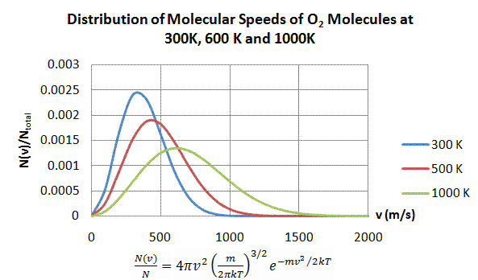
How higher temperatures also lead to greater choice (entropy)
More ways to distribute the hotter distribution b/c there is more energy to go around

Slide 17
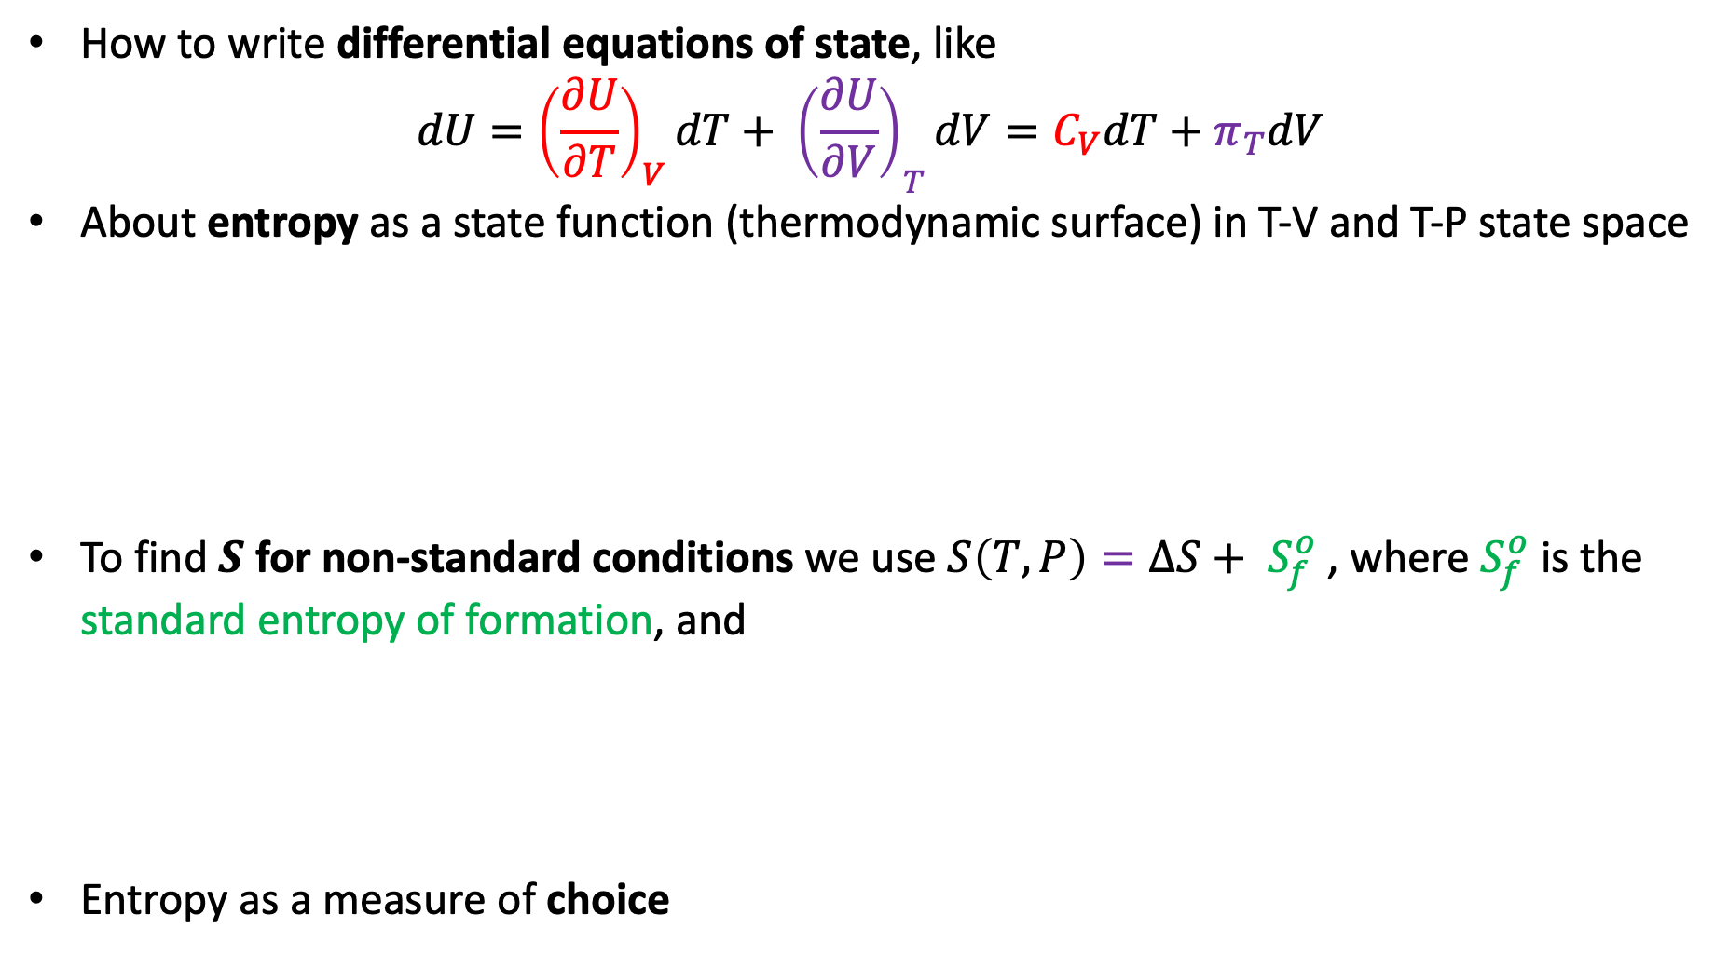
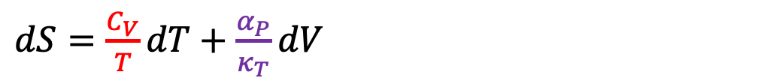
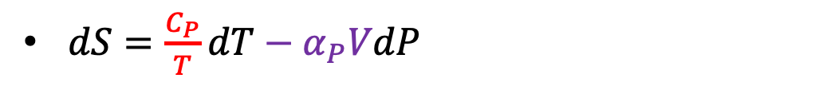
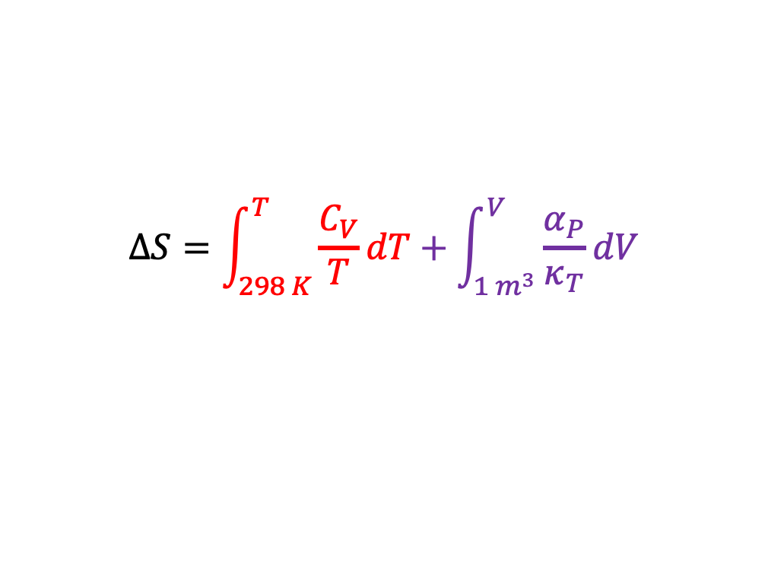
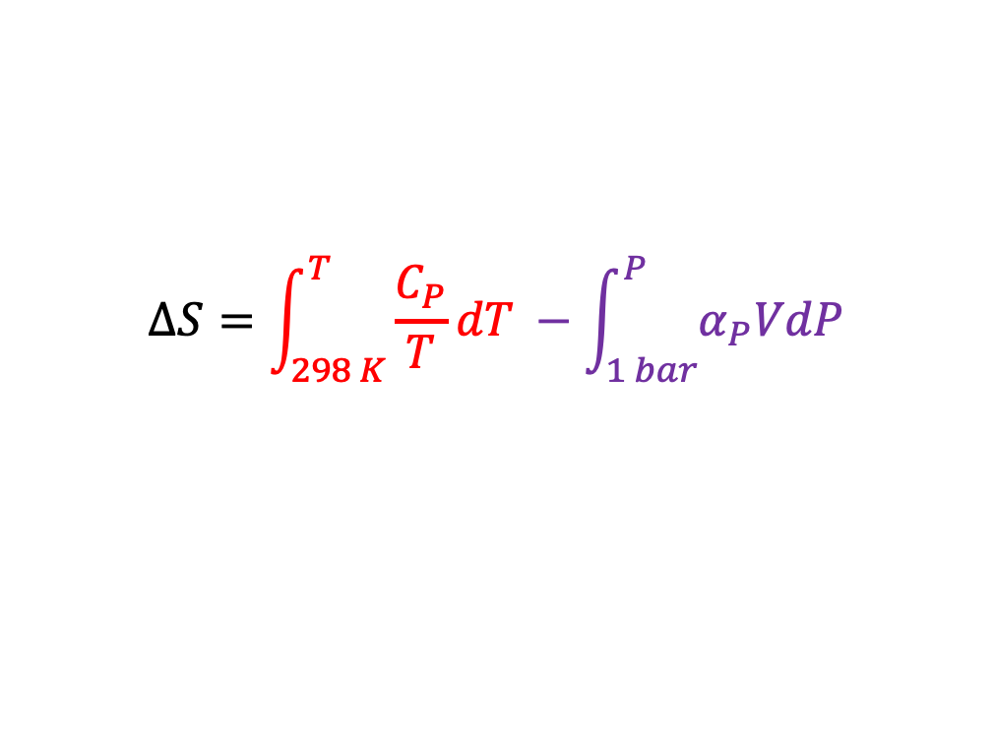
What we learned …
How to write differential equations of state, like
$$dU={{\left(\frac{∂U}{∂T}\right)}_{V}dT+ \left(\frac{∂U}{∂V}\right)}_{T}dV=C_{V}dT+π_{T}dV$$
About entropy as a state function (thermodynamic surface) in T-V and T-P state space
To find $S$ for non-standard conditions we use $S\left(T,P\right)={ΔS+ S}_{f}^{o}$ , where $S_{f}^{o}$ is the standard entropy of formation, and
Entropy as a measure of choice
$dS=\frac{C_{P}}{T}dT−α_{P}VdP$
$dS=\frac{C_{V}}{T}dT+\frac{α_{P}}{κ_{T}}dV$
or
$$ΔS=\int_{298 K}^{T}{\frac{C_{P}}{T}dT} −\int_{1 bar}^{P}{α_{P}VdP}$$
$$ΔS=\int_{298 K}^{T}{\frac{C_{V}}{T}dT}+\int_{1 m^{3}}^{V}{\frac{α_{P}}{κ_{T}}dV}$$
or

